Slide 1
Diátaxis and documentation responsibilities
Emma Hogan
ESMValTool Workshop
Tuesday, November 18, 2025
09:45 - 10:30 CET

Slide 2
Overview
🤷 What is Diátaxis? [5 minutes]
☑️How to use Diátaxis [5 minutes]
📃Case Study: Release documentation [5 minutes]
📝Plan for the coding sessions [5 minutes]
🗣️Discussion: Documentation responsibilities [15 minutes]
📋Summary [5 minutes]
❓Questions [5 minutes]

Slide 3
🤷What is Diátaxis?
Diátaxis is a systematic approach to writing technical documentation by understanding the needs of the users
https://diataxis.fr

Slide 4
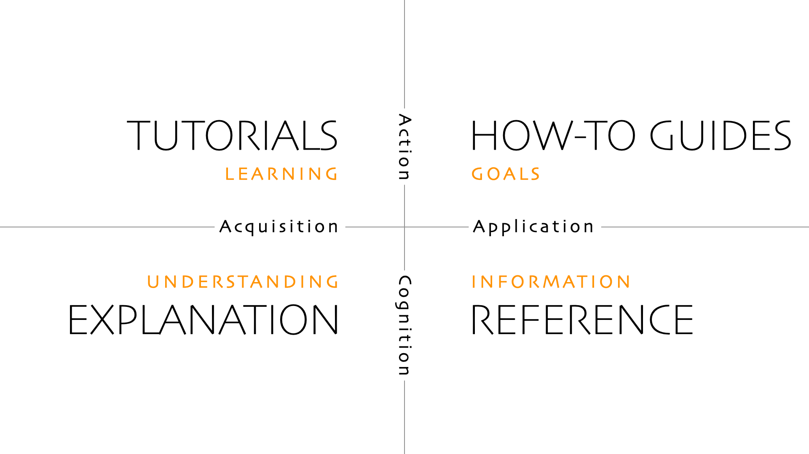
🤷What is Diátaxis?
Diátaxis identifies
and
four distinct needs
four corresponding forms of documentation
https://diataxis.fr
Notes:
+ One reason Diátaxis is effective as a guide to organising documentation is that it describes a two-dimensional structure, rather than a list.
+ Diátaxis identifies four distinct needs (learning, goals, understanding and information) and four corresponding forms of documentation (tutorials, how-to guides, explanation and reference materials).

Slide 5
🤷What is Diátaxis?
Diátaxis solves problems related to documentation:
📝 content (what to write)
✅ style (how to write it)
🗃️ architecture (how to organise it)
https://diataxis.fr

Slide 6
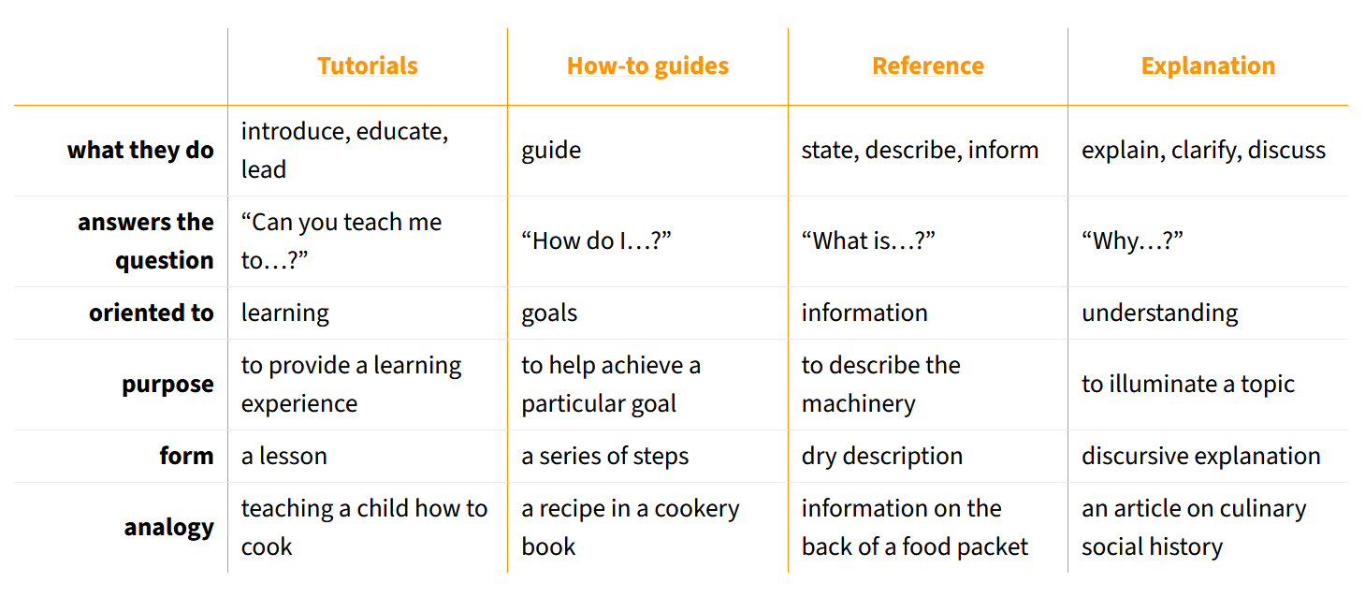
Diátaxis expectations and guidance
📖 for the reader
✍️ for the author
Diátaxis makes it clear:
what the purpose of the content is
how it should be written
where it should be placed
https://diataxis.fr/map/
Notes:
+ Diátaxis provides both clear expectations for the reader and guidance for the author.
+ The analogies are examples from food and cooking:
+ Tutorials:
+ It really doesn’t matter what is made, or how correctly it is made, the value of a lesson lies in what the baker gains, not what they produce.
+ We need the baker to learn things like: we wash our hands before handling food; how to hold a knife; why the oil must be hot; what this utensil is called, how to time and measure things.
+ How-to guide:
+ A professional chef who has made the same thing multiple times before may still follow a recipe to ensure that they do it correctly.
+ Even following a recipe requires at least basic competence.
+ Someone who expected to be provided with a recipe, and is given instead a cooking lesson, will be disappointed and annoyed.
+ Reference:
+ Are accurate, complete, reliable, neutral, and free of distraction and interpretation.
+ When you’re looking for information, you do not want to be confronted by opinions, speculation, instructions or interpretation.
+ Explanation:
+ Comprehensive, provide context and background, joins things together, and helps answer the question "why?"

Slide 7
☑️How to use Diátaxis
🦮 Use Diátaxis as a guide, not a plan
  Diátaxis helps you check that you’re in the right place and going in the right directions
😟 Don’t worry about structure
  Follow Diátaxis ➡️ Diátaxis structure, not the other way round
🪜 Work one step at a time
  It’s always possible to iteratively improve your documentation
https://diataxis.fr/how-to-use-diataxis/
Notes:
+ 09:50: Now I wanted to share how we can use Diátaxis as a guide to work.
+ Use Diátaxis as a guide, not a plan. Diátaxis describes a complete picture of documentation. However, the structure it proposes is not intended to be a plan, it’s a guide to help you check that you’re in the right place and going in the right directions.
+ Don’t worry about structure. Although structure is key to documentation, using Diátaxis means not spending energy trying to get its structure correct. If you continue to follow the prompts that Diátaxis provides, eventually your documentation will assume the Diátaxis structure, but it will have assumed that shape because it has been improved. It’s not the other way round, that the structure must be imposed upon documentation to improve it.
+ Work one step at a time. Diátaxis strongly prescribes a structure, but whatever the state of your existing documentation - even if it’s a complete mess by any standards - it’s always possible to improve it, iteratively.

Slide 8
☑️How to use Diátaxis: Just do something
Choose something
🤏
👤
👍
➕
Do it
Assess it
Decide what to do
⚙️
🔄️
➖
⬅️
https://diataxis.fr/how-to-use-diataxis/
Notes:
+ Diátaxis suggests the following approach to improve documentation:
+ Choose something. Any piece of the documentation. It could be the last file you worked on, the last page you read, or some random page, it doesn’t matter.
+ Assess it. Preferably it’s a small thing, nothing bigger than a page, and ideally smaller than that, like a paragraph or a sentence. Challenge it, according to the standards Diátaxis prescribes: What user need is represented by this? How well does it serve that need? What can be added, moved, removed or changed to serve that need better? Do its language and logic meet the requirements of this mode of documentation?
+ Decide what to do. Decide, based on the answers to the questions you just asked: What single action will produce an immediate improvement here?
+ Do it. Complete that single action, and consider it completed, i.e. commit the change. Don’t feel that you need to do anything else to make a worthy improvement.
+ Then go back to the beginning of the cycle.
+ Working like this helps reduce the stress of one of the most paralysing and troublesome aspects of the documentation-writer’s work: working out what to do.
+ It keeps work flowing in the right direction, always towards the desired end, without having to expend energies on a plan.

Slide 9
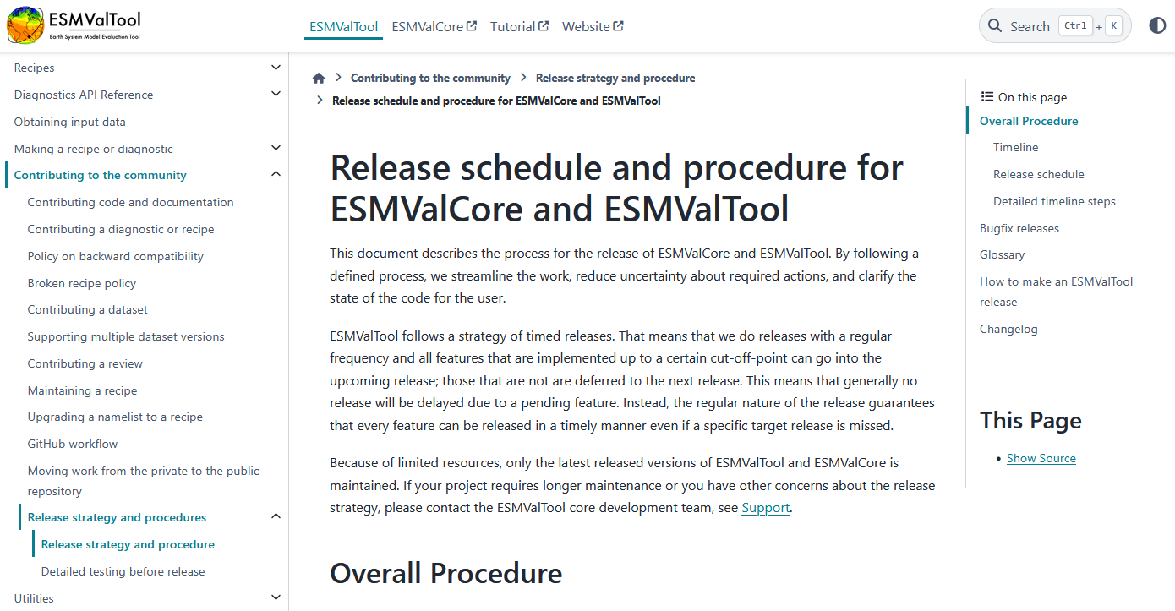
📃Case Study: Release documentation
https://docs.esmvaltool.org/en/latest/community/release_strategy/release_strategy.html
Notes:
+ 09:55.

Slide 10
📚Tutorials
🤷
Notes:
+ Tutorials: a lesson to introduce, educate, lead to provide a learning experience.

Slide 11
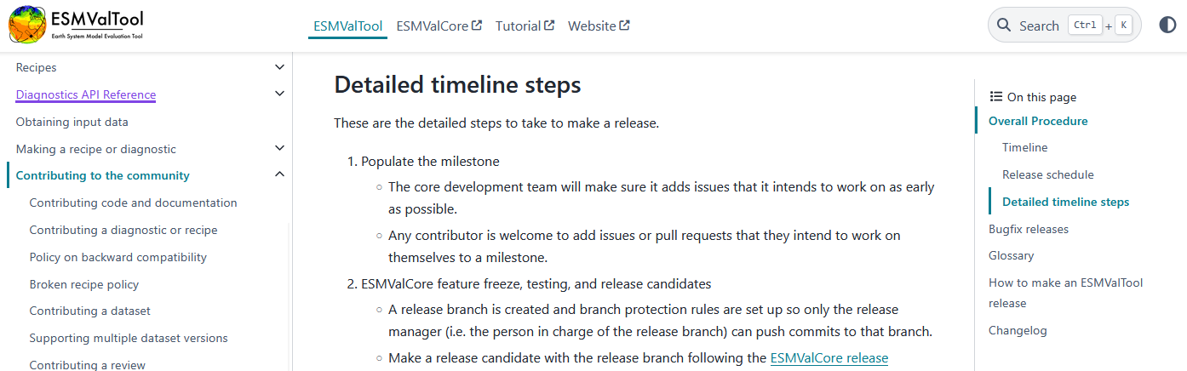
🛠️How-to guides
Notes:
+ How-to guides: a series of steps to help achieve a particular goal.
+ Current documentation is nicely detailed in a step-by-step manner.

Slide 12
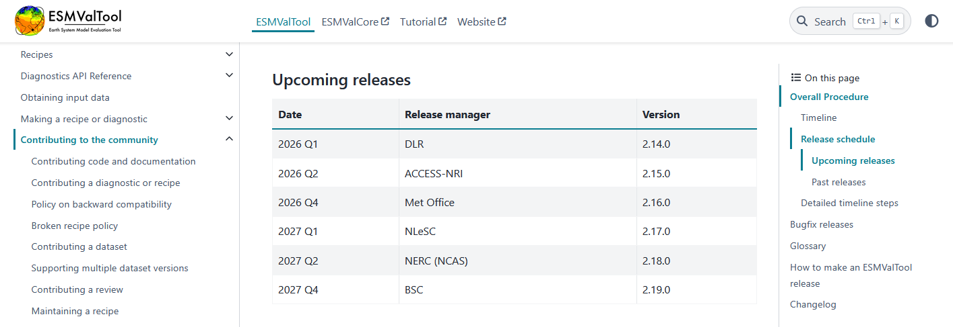
📖Reference materials
Notes:
+ Reference materials: state, inform to describe the machinery.

Slide 13
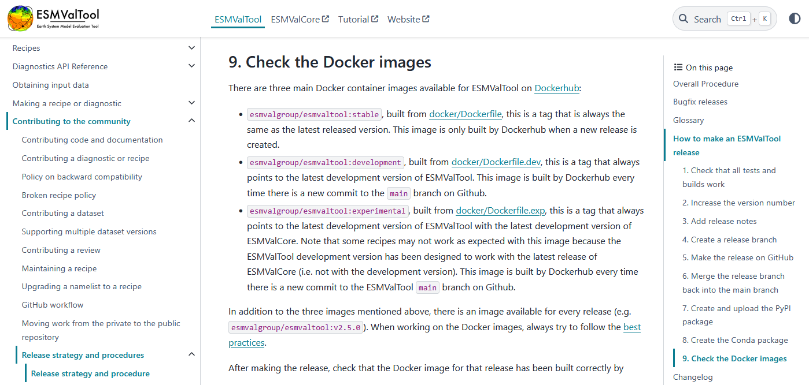
💡Explanations
Notes:
+ How-to guides: a series of steps to help achieve a particular goal.
+ Explanations: comprehensively explain, clarify, discuss to illuminate a topic.

Slide 14
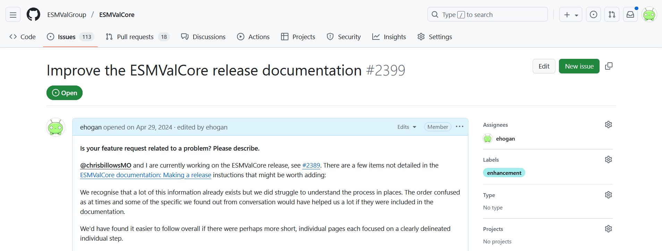
📝Plan for the coding sessions
Notes:
+ 10:00: Chris and I opened an ESMValCore issue to improve the ESMValCore release documentation after the Met Office performed the v2.11.0 release in July 2024.
+ This was before I suggested using Diátaxis for the ESMValTool documentation, and it’s clearer to me now how we can incrementally improve the release documentation.
+ I would like to start the coding session this afternoon with a planning meeting to discuss what changes we should make / what changes would be the most beneficial.
+ Please join us!

Slide 15
🗣️Discussion: Documentation responsibilities
How do we distribute documentation responsibilities? One example:
📝 content: TLT?
✅ style: UET?
🗃️ architecture: UET?
TLT = Technical Lead Team
UET = User Engagement Team
Notes:
+ 10:05: Now onto the discussion!
+ The UET are responsible for all aspects of the tutorials, but for the documentation it is less clear.
+ It would be great for us to decide who would be responsible for which aspects of the documentation for the purposes of adding it to our long-term strategy, rather than for the purposes of deciding who will do what and when.
+ One example might be for:
+ the TLT to own the content (what to write: details, accuracy, maintainability)
+ the UET to be responsible for the user experience (how to write it, how to organise it: structure, entry points)
+ What else needs clear ownership?

Slide 16
📋Summary
💡Diátaxis is a systematic approach to writing technical documentation
👀Diátaxis identifies:
  🫴four distinct needs (learning, goals, understanding and information)
  📃four corresponding forms of documentation (tutorials, how-to guides, explanation and reference materials)
👥Stop and consider the needs of the users when writing documentation
🔄️We should aim to improve the ESMValTool documentation iteratively
❓Any questions?
Notes:
+ 10:20.

Slide 17
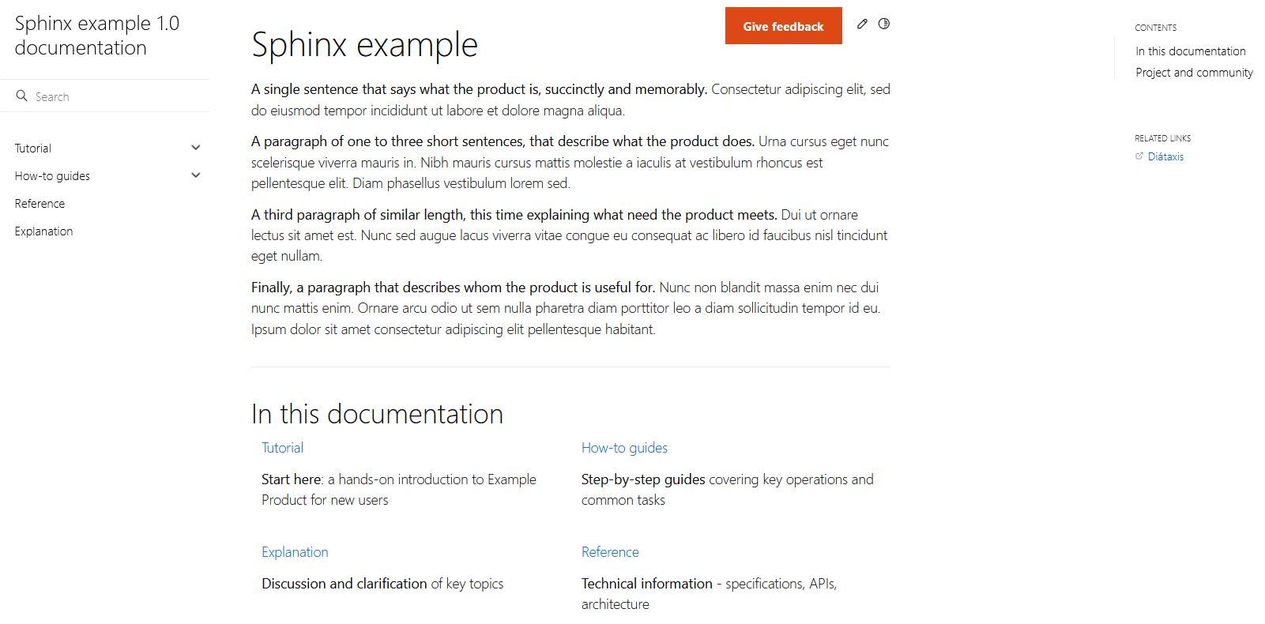
https://canonical-example-product-documentation.readthedocs-hosted.com/en/latest/
Notes:
+ An example for Sphinx documentation following Diátaxis.

